Slide 1
SCADA TRAINING
SCADA CONTROLLERS
AJAY K BASU
akbasu48@gmail.com

Slide 2
What is a controller?
Controller is the control equipment, which sits in between the SCADA host and the field equipment as illustrated by the figure below.
All modern day controllers are computers or microcontrollers with memory and I/O ports and support programming.
They supply information about field devices to master system and carry out commands for monitoring and control of field devices.
Being industrial equipments, they can operate in harsh environment.

Slide 3
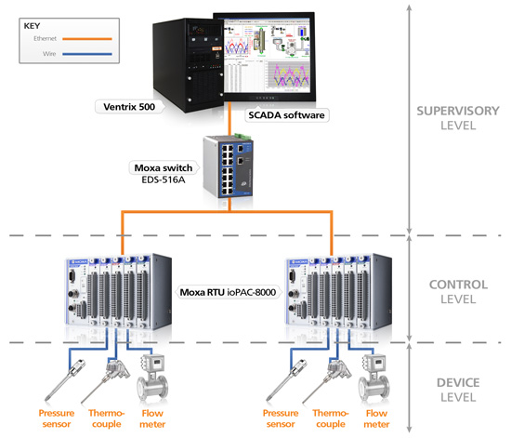

Slide 4
What is a controller?
Depending on their features and sequence of appearance in the evolution process, controllers are known by various names and vary in their scale and functionalities.
Programmable Logic Controller (PLC), Remote Terminal Unit (RTU) and Programmable Automation Controller (PAC) are examples of controllers
Features of modern controllers are given below. All these features are not present in all controllers.

Slide 5
Features of controllers
Microprocessor/microcontroller based with proper primary and secondary storage capacity for the desired application
Operate on standard operating systems (e. g. UNIX)
Support modern standard programming languages (e. g. c / c ⁺⁺ / Java)
Can control field devices – generally using control relays
Accepts both continuous or discrete, analog and digital inputs

Slide 6
Features of controllers
Provides both continuous or discrete, analog or digital outputs to the field devices for control.
Support a wide range of connectivity – serial and parallel, wired and wireless.
Support a wide range of protocols for communication
Capable of operating in site climate, which often rugged.

Slide 7
Features of controllers
Remotely upgradable firmware
Web interface
Pager and email alert
Open (non-proprietary) protocol for communication
Support derived alarm and control (software-based alarms that occur whenever a user-defined combination of events occurs)

Slide 8
Features of controllers
Integrated hub
Certification and compliance - for enclosure, emission, safety etc.
Visual and audible alerts and alarms. Alarm Qualification to Prevent Nuisance Alarms.
Single or multi-level access security

Slide 9
Features of controllers
Windows Provisioning Software – capability to be configured with a desktop/laptop
Real time clock
Chassis - size & mounting
Battery support
Communication redundancy – alternate path reporting

Slide 10
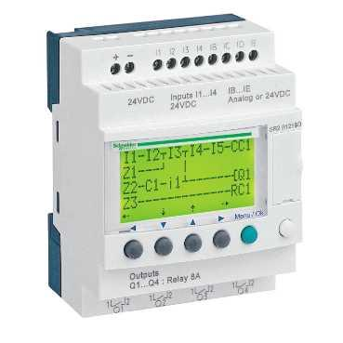
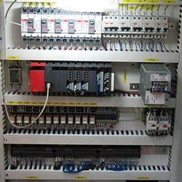
PLC
A PLC
A PLC Panel

Slide 11
PLC
PLC is a digital computer/microcontroller designed to handle multiple inputs and outputs. It is rugged in design to withstand harsh industrial environments.
PLC receives inputs from sensors to notify an incoming event (e.g water level has exceeded a certain limit)
PLC output line actuates a device as a reaction to the incoming event (e.g. close a valve or stop a pump)

Slide 12
PLC
Uses programmable memory to store instructions and specific functions like on/off control, timing, counting, sequencing, arithmetic processing and data handling.

Slide 13
Scanning in PLC
When a PLC is running, it continuously scan inputs and outputs in 4 phases –
Input scan
Program Execution – processes and executes program logic
Housekeeping – includes diagnostics, communication etc.
Output scan – energize/de energize output

Slide 14
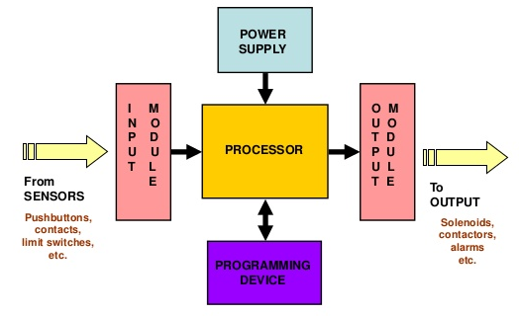
Components of a PLC

Slide 15
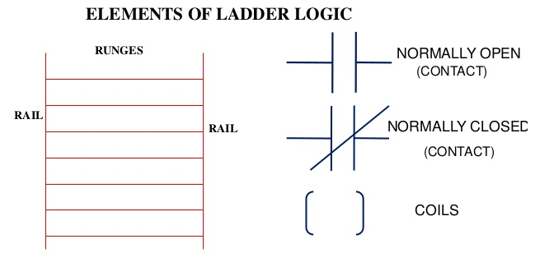
Programming PLC
Ladder Logic is most common programming
language for PLC

Slide 16
Communication with PLC
Supports serial asynchronous and parallel communication
Serial communication standard RS232, RS 422 and RS 485
Supports parallel communication standard IEEE 488 (GPIB)
Parallel data communications can take place between listeners , talkers , and controllers.
There are 24 lines: 8 data (bidirectional), 5 status & control, 3 handshaking, and 8 ground lines.

Slide 17
PLC standard – IEC 61131
IEC 61131 is an open international standard for Programmable Logic Controllers (PLC).
It is divided in nine parts (61131-1to 61131-9) - General Information, Equipment Requirements and Tests, Programming Languages, User Guidelines, Messaging Service Specifications, Functional Safety, Fuzzy Control Programming, Guidelines for the application and implementation of programming languages and Single-drop Digital Communication Interface for small sensors and actuators (SDCI).
Of particular interest is 61131-3, which provides basis for PLCopen, the global standard for Industrial Control Programming.

Slide 18
PLC programming standard
IEC 61131-3 PLC Programming - PLCopen
The third part defines, as a minimum set, the basic programming elements, syntactic and semantic rules for the most commonly used programming languages. This includes the graphical languages Ladder Diagram and Functional Block Diagram, and the textual languages Instruction List and Structured Text, as well as means by which manufacturers may expand or adapt those basic sets to their own programmable controller implementations.

Slide 19
RTU
A remote terminal unit (RTU) is a multipurpose device used for remote monitoring and control of various devices and systems for automation. It is typically deployed in an industrial environment and serves a similar purpose to programmable logic controller (PLC) but to a higher degree.

Slide 20
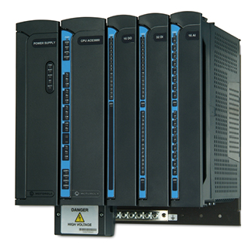
RTU

Slide 21
RTU
In SCADA systems, an RTU is a device installed at a remote location that collects data, codes the data into a format that is transmittable and transmits the data back to a central station, or master. An RTU also collects information from the master device and implements processes that are directed by the master. RTUs are equipped with input channels for sensing or metering, output channels for control, indication or alarms and communications ports.

Slide 22
Characteristics of RTU
Provide superior intelligence, communication and flexibility
Rugged and reliable hardware construction
Extensive programming and performance capabilities
Broad communication and protocol support
Local control
Ease of maintenance and upgradability
Scalability
Security

Slide 23
RTU Design
The RTUs shall be designed in accordance with applicable International Electro- technical Commission (IEC), Institute of Electrical and Electronics Engineer (IEEE), American National Standards Institute (ANSI), and National Equipment Manufacturers association (NEMA) standards, unless otherwise specified in this technical specification. In all cases the provisions of the latest edition or revision of the applicable standards in effect shall apply.

Slide 24
RTU Functions
All functional capability described herein shall be provided by the Bidder even if a function is not initially implemented.
As a minimum, the RTUs shall be capable of performing the following functions:
A. Collecting and processing the digital status inputs, analog inputs, accumulated values and transmitting to master station
B. Receiving and processing digital & analog control commands from master station
C. Accepting polling messages from master station.
D. Communication simultaneously on all Communication ports and using multiple concurrent protocols, including the IEC 60870-5-101, 60870-5-104 & MODBUS/103 protocol.

Slide 25
RTU Functions
E. Data transmission rates from 300 to 9600 baud for serial ports (for both IEC 60870-5-101 & MODBUS/103) and 10/100 Mbps for TCP/IP Ethernet ports.
F. RTU shall support protocol 61850 for communication with IEDs.
G. RTU shall have the capability of automatic start-up and initialisation following restoration of power after an outage without need of manual intervention. All restarts shall be reported to the connected master station.
H. RTU shall support time synchronization through messages received from master station.
I. RTU shall support downloading of RTU database from the master station.
J. RTU shall support SOE (Sequence of events) feature

Slide 26
Communication Ports in RTU
The RTUs shall support simultaneous communications with master station, maintenance and configuration terminal (Laptop PC), a local logger (printer), Multi-function transducers and Local Data Monitoring System (LDMS)/Logger.
The RTUs shall have communication ports as follows:
A. Two Ethernet ports for connectivity to Master Station on IEC 60870-5-104
B. 2x RS232 ports
C. One port for the RTU maintenance and configuration terminal.
D. One port for Local Data Monitoring System (LDMS) and local logger (printer).

Slide 27
Communication Ports in RTU
E. Required number (minimum two) of RS 485 ports for polling Multi-function transducers using MODBUS/103 protocol in multi-drop (party line) mode
It shall be possible to increase the number of communication ports in the RTU by addition of cards, if required in future. The RTU shall respond to independent scans and commands from Master Station, LDMS and Configuration & Maintenance Terminal simultaneously. The RTU shall support the use of a different communication data exchange rate (bits per second) and scanning cycle on each port.

Slide 28
RTU Power Supply
The RTU will be powered from a 48V DC system.
The characteristics of the input DC power supply shall be
A. Nominal voltage of 48V DC with operation between 41 and 60V DC
B. Maximum AC component of frequency equal to or greater than 100 Hz will be 0.012 times the rated voltage peak-to-peak.
C. The RTU shall have adequate protection against reversed polarity, over current and under voltage conditions, to prevent the RTU internal logic from being damaged and becoming unstable causing mal-operation.

Slide 29
RTU Environmental Requirements
The RTU should be able to operate in areas with no temperature or humidity control. The RTUs shall be capable of operating in ambient temperature from 0 to +55 degree C with rate of temperature change of 20 degree C/hour and relative humidity less than 95%, non-condensing.

Slide 30
RTU Portable Configuration and Maintenance Terminal (PCMT)
The bidder shall supply a Portable Configuration and Maintenance Terminal (Laptop PC) which shall provide followings capabilities:
A. RTU Data Base Configuration & Maintenance
B. Local Operator Interface & RTU Diagnostics
C. Master Station and RTU simulator cum
protocol analyser

Slide 31
RTU Wiring/Cabling requirements
Shielded (screened) cables shall be used for external Cabling from the RTU/ SIC panels.
All cables shall have stranded copper conductor of suitable cross section depending on load.
The Communication cable shall be of shielded, twisted pairs and of minimum 0.22 sq mm size.

Slide 32
